Slide 1

We are glad to have you
as a new rider on the
happening track of CARS24.
Fasten up your seat belt
because it’s going to be
a rocking ride.

Slide 2




Follow Up Calling Script
Objective - Structured and planned follow up calling to close the deal

Slide 3



Do Remember!
3
Calling Essentials
Negotiation
Objection Handling
Have notes handy
Sit straight and confident
Wear a smile
Build Rapport
Active listening
Have inspection report handy
Breaking CEP
Do not increase the price on the same call
Make multiple efforts on the same CRP pointer and then pick the next one
ACC
(Acknowledge
Counter
Closer)
Notes:
- Be ready
Keep the pipedrive
Sounds
Keep the pointers in mind

Slide 4
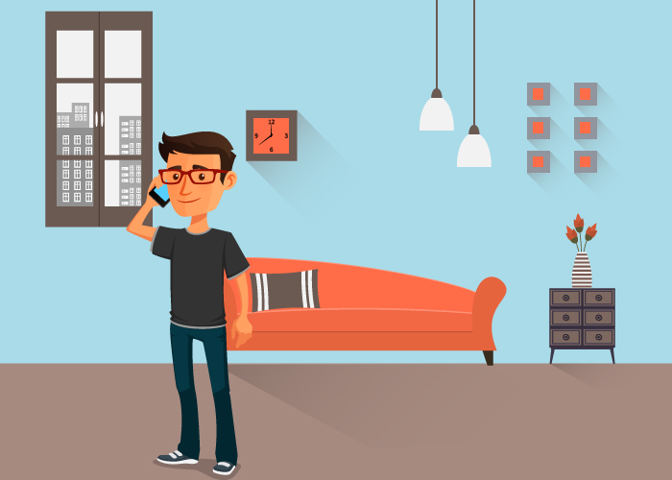



Why Follow Up Call :: Two Scenarios
4
Price Already Communicated
At The Branch
Price Not Communicated
At The Branch

Slide 5

Call Opening
5
Price not communicated at the branch (over the call)
Good Morning Mr. Vikram, my name is Sahil, I am calling from Cars24. This call is in reference to your car (mention the car make, model, year) which you got inspected on (mention the date).
(Say with a Smile )*– “I am glad to inform you that we have got 120 bids on your car and in order to close this deal I would like to catch up with you at our branch so that I can show you the detailed report and then we can discuss and close the deal.
So Mr. Vikram would you like to come today evening (e.g. 5.30 PM) or tomorrow morning( 10.30 AM) to close the deal.
Price already communicated at the branch
Good Morning Mr. Vikram, my name is Sahil, I am calling from Cars24. This call is in reference to your car (mention the car make, model, year) which you got inspected on (mention the date).
We offered you the best price in the market which is Rs. XX. So Mr. Vikram would you like to come in evening (e.g. 5.30 PM).

Slide 6
Objection Handling

Slide 7

1 :: Customer Insists To Know The Price over the call
7
Definitely sir I would love to do that. Since you are selling your important asset, I would like to suggest that you should go through the detailed report in person and then I can help you to understand that how do we derive the best price from the market .
So Mr. Vikram would you like to come today evening (e.g. 5.30 PM) to close the deal.
Why don’t you tell me the price and then I can decide

Slide 8
Customer Insists To Know The Price Over The Call…continued
7
Certainly sir ,I am glad to share that we got 120 (one hundred and twenty) bids on your car , bidding started from Rs. X and average bidding was at Rs. X ,second highest bid was Rs. X and difference between second and the highest bidder is of Rs.X and the best price is Rs. XX which will be transferred to your account instantly, once we close the deal.
So Mr. Vikram would you like to come today evening (e.g. 5.30 PM) to close the deal.
Yes, but tell me the price and then only I will decide?

Slide 9
2 :: Cars24 Price Looks Very Less
8
I understand sir, you had a different expectation however let me share that we have shown your car to more than 120 + certified buyers. The average bidding was at Rs.XXX and second highest person who has bidded is of Rs.XX , difference between second highest and highest is Worth Rs. XX and I am sure the price is the best price derived from market.
So Mr. Vikram, since the bid is valid until today evening only, so let’s catch up at the branch today evening to discuss more details and close the deal. How about today at 5:30 PM?
Bus Iatna hi / I will not give the vehicle at this price
Notes:
Vandana to mention – Required docuemnts – one cancelled cheque, One Photo, ID and Address proof

Slide 10
Cars24 Price Looks Very Less…Continued
8
Sir , I understand your expectation. My team has put in the best of efforts to derive the best price from market. Also, considering our historical transaction trends, I assure you that this is the best price.
Not only this, we also assure you instant payment and free RC transfer which no one else can offer in the market.
Our documentation process is very transparent and customer friendly.
And, Mr. Vikram, since the bid is valid until today evening only so let’s catch up at the branch today evening to discuss more details and close the deal. How about today at 5:30 PM?
But, I am expecting more for my car
Notes:
Vandana to mention – Required docuemnts – one cancelled cheque, One Photo, ID and Address proof

Slide 11
3 :: When Customer Demands A Specific Price
8
Okay sir, I understand your expectation. Let me share we have been interacting with 100 of customers every day and when a car owner decides to sale his car there is always an expectation, however car price depends on multiple factors like make, model, variant, year of manufacture, ownership, KMs driven etc. and many more factors. We have experts team associated with us who work to derive the best price for your car.
So Mr. Vikram would you like to come today evening (e.g. 5.30 PM) to close the deal.
I think it should be Rs.XX (e.g. - 5 Lac)
Notes:
Vandana to mention – Required docuemnts – one cancelled cheque, One Photo, ID and Address proof

Slide 12
4 :: There Is Another End Buyer (Friend, Relative Etc.)
8
Well sir I understand that, However let me tell you that 80%+ car sellers in India do struggle after selling their car to an individual. They face issues like incomplete money transaction, documentation, and ownership transfer issues and this all lead to risk to get stuck in legal issues or ending up in complicated situation with friends/relatives.
I am not stopping you by evaluating other options, however, I am worried that your car selling experience should be smooth and post selling your car should be in right hands. And, therefore I will strongly recommend that while selling your such an important asset you should go with well structured and transparent method which offers you peace of mind along with instant payment , free RC transfer and complete documentation.
Mr Vikram I would suggest if we can catch up at branch I can help you further in decision making. However final decision is yours only , so how about catching up today at 5.30 PM.
I have got higher price from my neighbour
Notes:
Vandana to mention – Required docuemnts – one cancelled cheque, One Photo, ID and Address proof

Slide 13
5 :: Comparison With Other Online Portals
8
Yes, sir I got your point however this is my responsibility to tell you that there is a big difference in the woking of cars24 and any other online portal. Such online portals offers you to post the advertisement and you only have to deal with multiple people and deal. This will also demand displaying and opening your car multiple times. And, on the other side cars24 offers you end to end seamless experience of car selling because we derive the best price from certified buyers in the market and take care of your instant payment and all paper documentation.
Therefore I Am sure you would like to go ahead with a one point solution which offers you the best price.
Mr Vikram I would suggest if we can catch up at branch I can help you further in decision making. However final decision is yours only , so how about catching up today at 5.30 PM.
I am already getting a better deal from OLX / other online portal
Notes:
Vandana to mention – Required docuemnts – one cancelled cheque, One Photo, ID and Address proof

Slide 14
Comparison With Other Online Portals…Continued
8
Sir I understand your point , However, as I told you that multiple people will try and offer fake quotes and they will always look forward to initiate the conversation. We also have heard this from many customers that once they catch up in person with those people they reduce their initial quote by multiple folds which actually causes a lot of time wastage to the car owner and hassle around so many coordination. Also, you would agree that there is no one who takes the ownership of your RC transfer and other documentation.
Therefore I would sincerely suggest let's catch up at branch once today and we will help you to sell your car at best price in a structured way. How about today 5:30 PM?
No but still he is ready to offer me more than your quote
Notes:
Vandana to mention – Required docuemnts – one cancelled cheque, One Photo, ID and Address proof

Slide 15
6 :: Exchange Against The New Car
8
Yes, sir I understand this very well. There is a negotiation on the value of your used car. The sales executive will smartly offer you a higher price and this is their smart way of gaining your trust by making you believe that you are getting an amazing deal for your used car.
Unfortunately, this is a trap as later they give you significantly less discount than what he could have actually offered on the new car. Why don’t you test it out yourself?
Go to a new car dealership to buy a car. Separately, send a friend/family member to buy a new car in exchange of their used car. You would understand that the extra money offered for your used car would mean a smaller discount on your new car. Who will bear the loss for this? Definitely you!.
Therefore, Mr. Vikram I would sincerely suggest let's catch up at branch once today and we will help you to sell your car at best price in a hassle free way. So how about today at 5:30 PM?
I will not give the vehicle at this price/ I am getting a better offer in exchange of new car
Notes:
Vandana to mention – Required docuemnts – one cancelled cheque, One Photo, ID and Address proof

Slide 16
Not To Forget
8
ACC Technique : Acknowledge counter and closure
1
Be Prepared - Notes handy, inspection report handy, be confident
2
Reiterate USPs : Best price , Instant payment , Free RC transfer
3
Logic of getting price : Make model, year, variant, Ownership no. of bids, our auction model with certified buyers, and our historical transaction trends
4
Discuss one CEP (Customer expected price) at a time : Pick one of the most appropriate breaking CEP pointer and convince on that with full conviction before jumping on next CEP
5
Pursue the customer to visit branch and close the deal
6
Notes:
Vandana to mention – Required docuemnts – one cancelled cheque, One Photo, ID and Address proof

Slide 17


